Slide 1
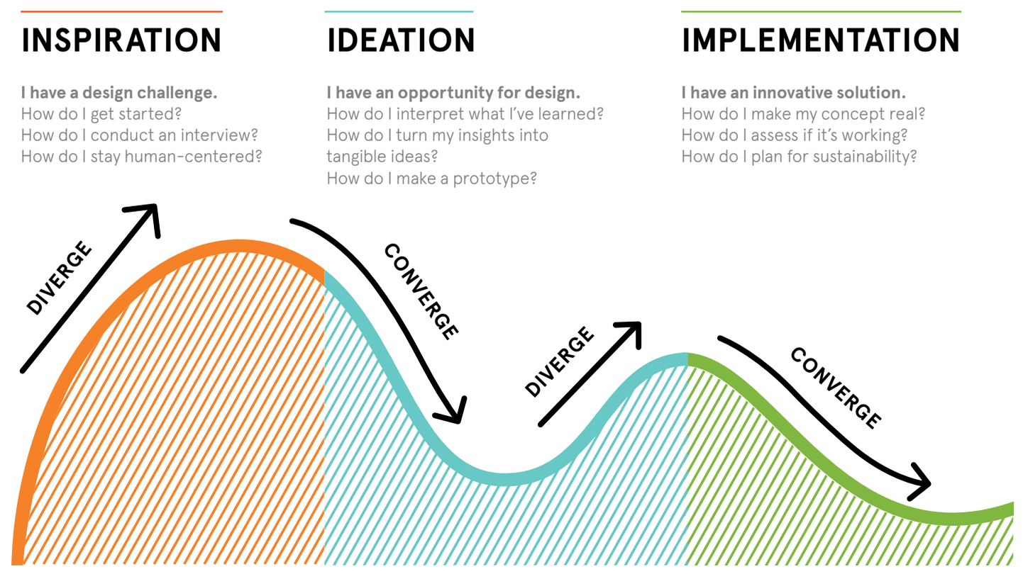

Slide 2
Discovery
Prof. Dr. Mohd Shafry Mohd Rahim

Slide 3
HUMAN-CENTRED DESIGN
Phase 1: Discover

Slide 4
Creating meaningful solutions begins with gaining a deep understanding of people’s needs.

Slide 5
DISCOVERING
listening
observing
being open to the unexpected
new experiences and perspectives

Slide 6
5 Steps … to do a discovery …
1. DESIGN CHALLENGE
2. PLAN YOUR RESEARCH METHODS
3. BUILD YOUR DISCUSSION GUIDE
4. CAPTURE YOUR LEARNINGS
5. CONSTRUCT YOUR FINDING
THANKS ……

Slide 7
STEP 1
DESIGN CHALLENGE
Design Challenge is a statement that help create better solutions to society’s most complicated problems. We support innovators and entrepreneurs to design products and services with real social impact.
People are inspired to ………….. ?
^{Collect thoughts}
^{Review what you already know}
^{Define what you don’t know}
^{Review constraints or barriers}

Slide 8
STEP 2
PLAN YOUR RESEARCH METHODS
1. Learn from users
2. Talk with experts, near and far
3. Immerse yourself in context
4 Seek inspiration in analogous settings

Slide 9
STEP 3
BUILD YOUR DISCUSSION GUIDE
Build tangible conversation starters
Identify objectives
Confirm your plans
Word questions strategically
Create a question guide
Assign roles
Organize your questions

Slide 10
STEP 4
CAPTURE YOUR LEARNINGS
Take time to regroup
Share your impressions
Illustrate new ideas

Slide 11
STEP 5
CONSTRUCT YOUR FINDING
Problem Background
Motivations
Goal
Objectives
Scopes

Slide 12
Next Class Presentation

Slide 13

STATE YOUR CHALLENGE

Slide 14
TEAM KNOWLEDGE & ASSUMPTIONS
What are the aspects of the challenge that you already know a lot about? What are your assumptions?
#1 …………...
#2 ……………
#3 ……………

Slide 15
RESEARCH PLAN
^{Community Members}
^{to Visit}
^{Experts to Speak To}
^{In-Context}
^{Immersion}
^{Locations}
^{Analogous}
^{Research Locations}

Slide 16
BUILD A QUESTION GUIDE
Start specific
What are some specific
questions you can ask
to open the conversation
and help people
feel comfortable?
Then go broad
What are some questions
that can help you start
to understand
this
person’s hopes,
fears, and ambitions?

Slide 17
CONDUCT YOUR RESEARCH
1. Result of Interview Session
2. Result of Observation of the
people an location
3. Sketch your Empathy
and Sympathy
4. Note & Photo of your observation

Slide 18
WRITE YOUR DISCOVERY REPORT

